Slide 1
Phase Retrieval
ECE 554 Final Presentation
Amir Reza Vazifeh
December 17, 2024

Slide 2
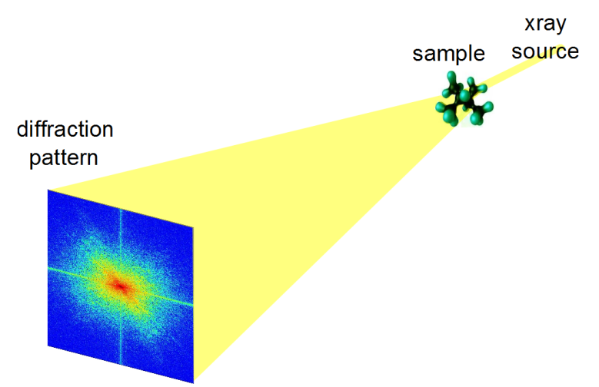
Outline
Why Does Phase Matter?
When Is Phase Lost?
How Difficult Is Phase Retrieval?
Algorithms for Phase Retrieval
Current Research

Slide 3
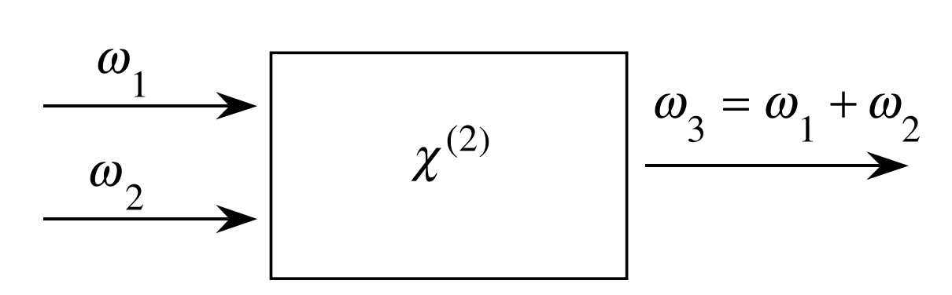
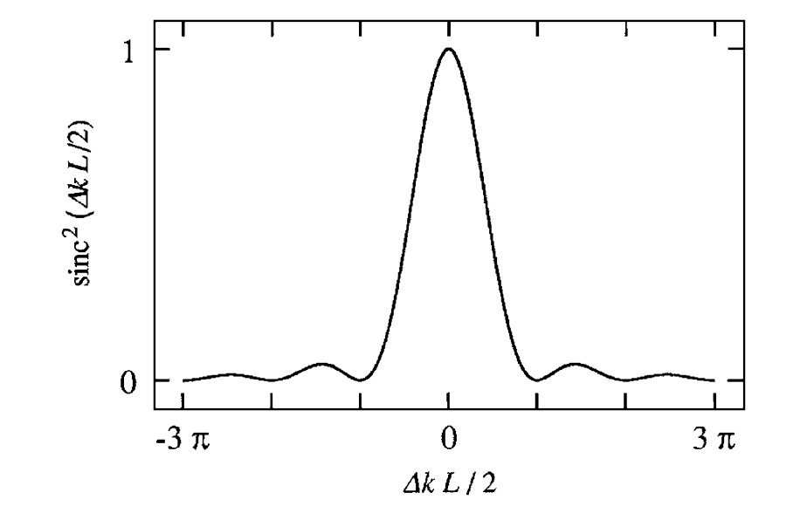
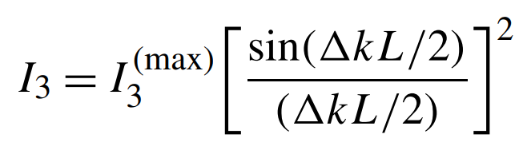
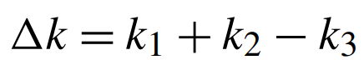
Relevance: Phase Matching
Intensity of generated wave
Significant reduction in sum-frequency generation efficiency occurs when $Δk ≠0$. (No perfect phase-matching)
Ref: Nonlinear Optics, Robert W. Boyd, Chapter 2

Slide 4
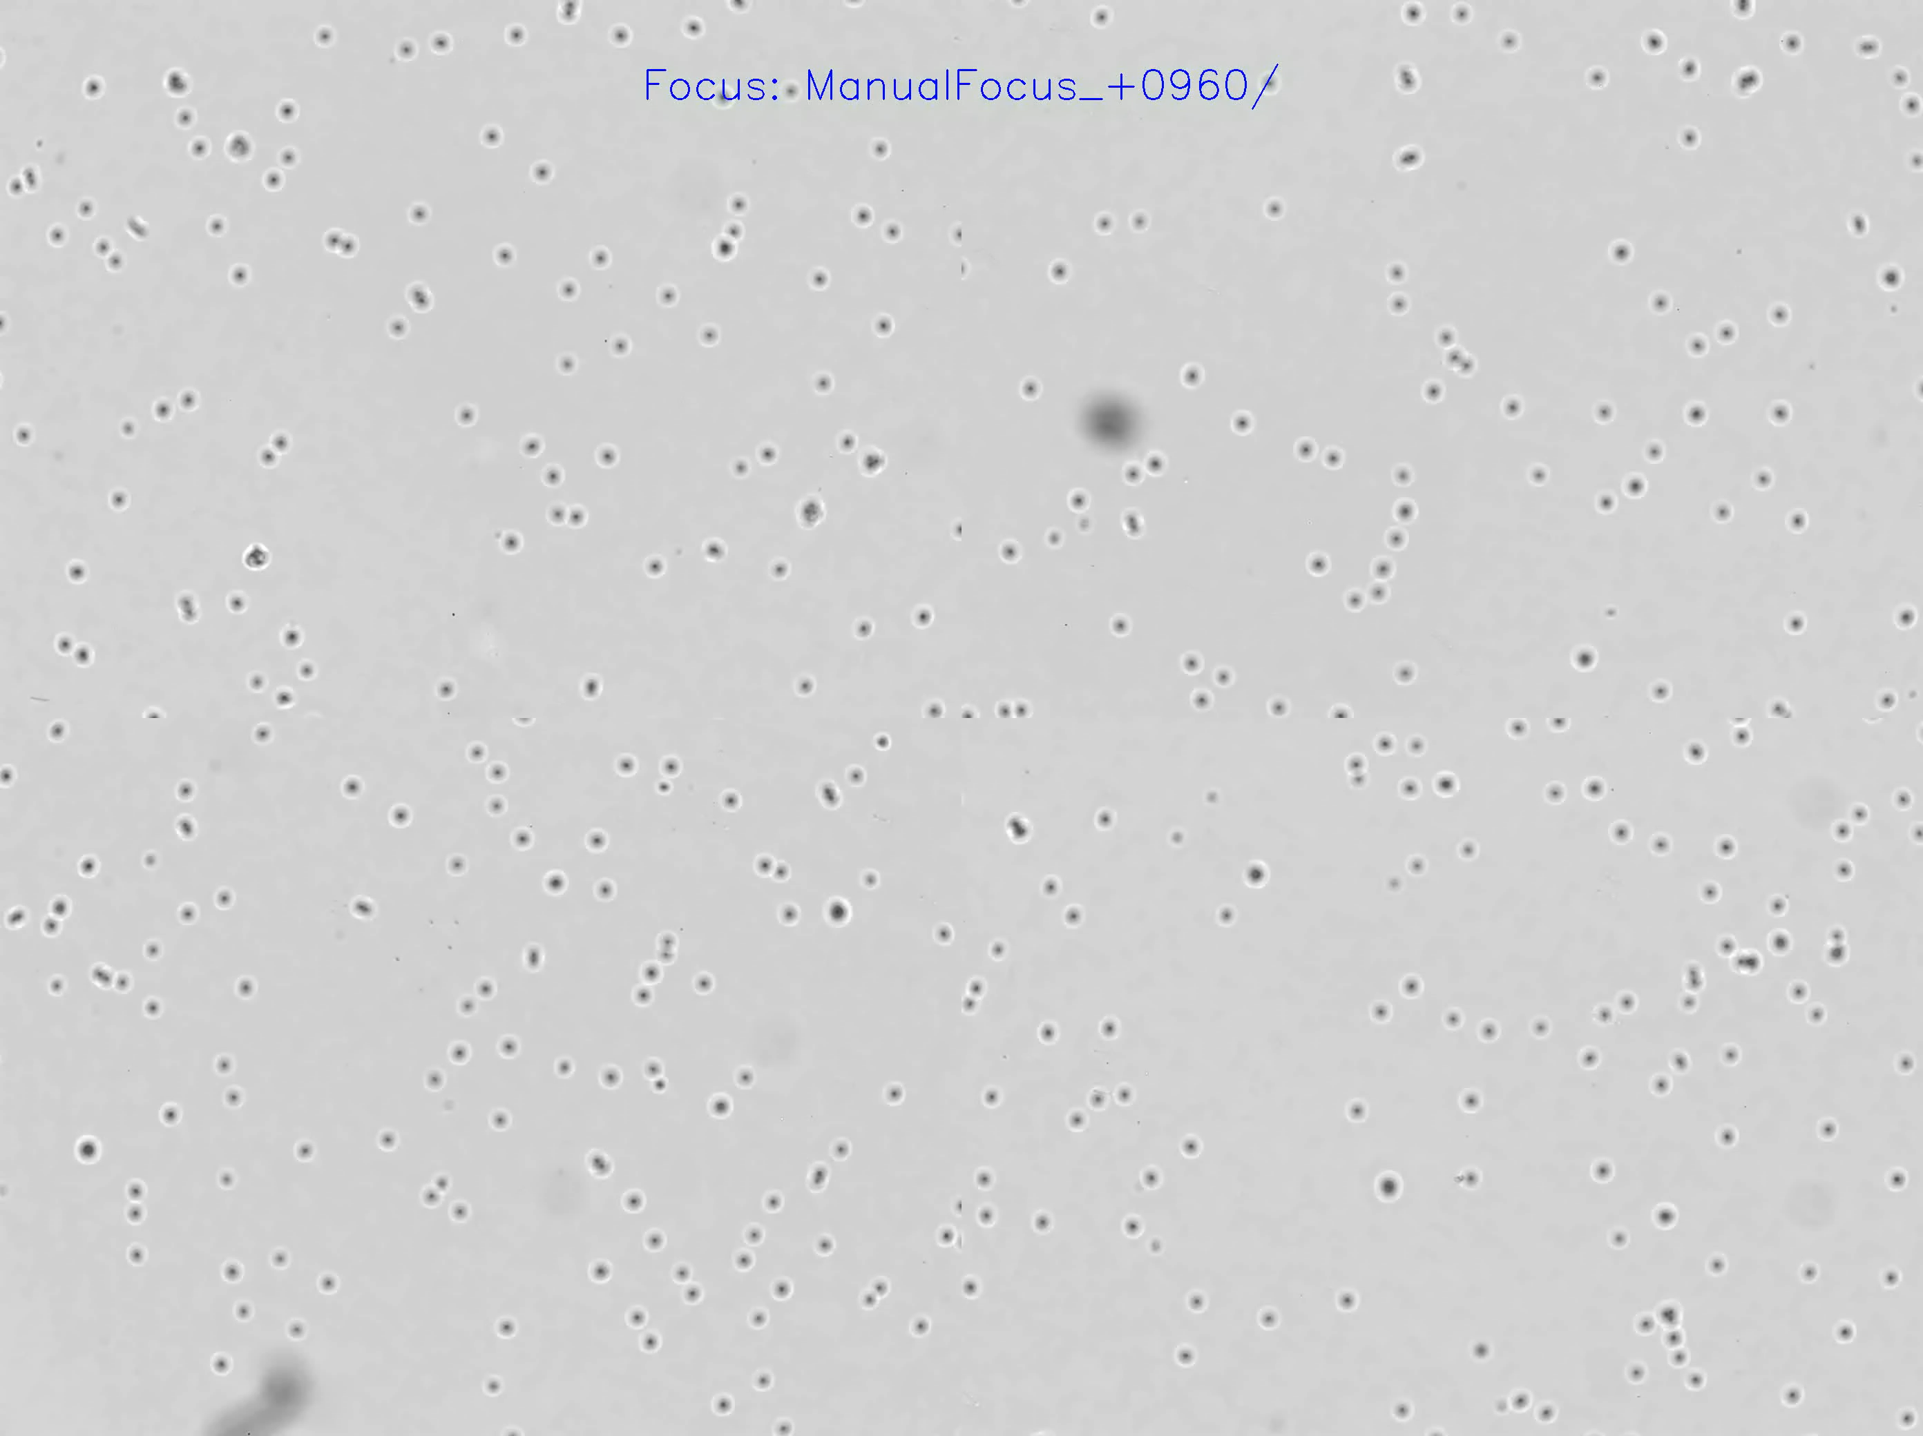
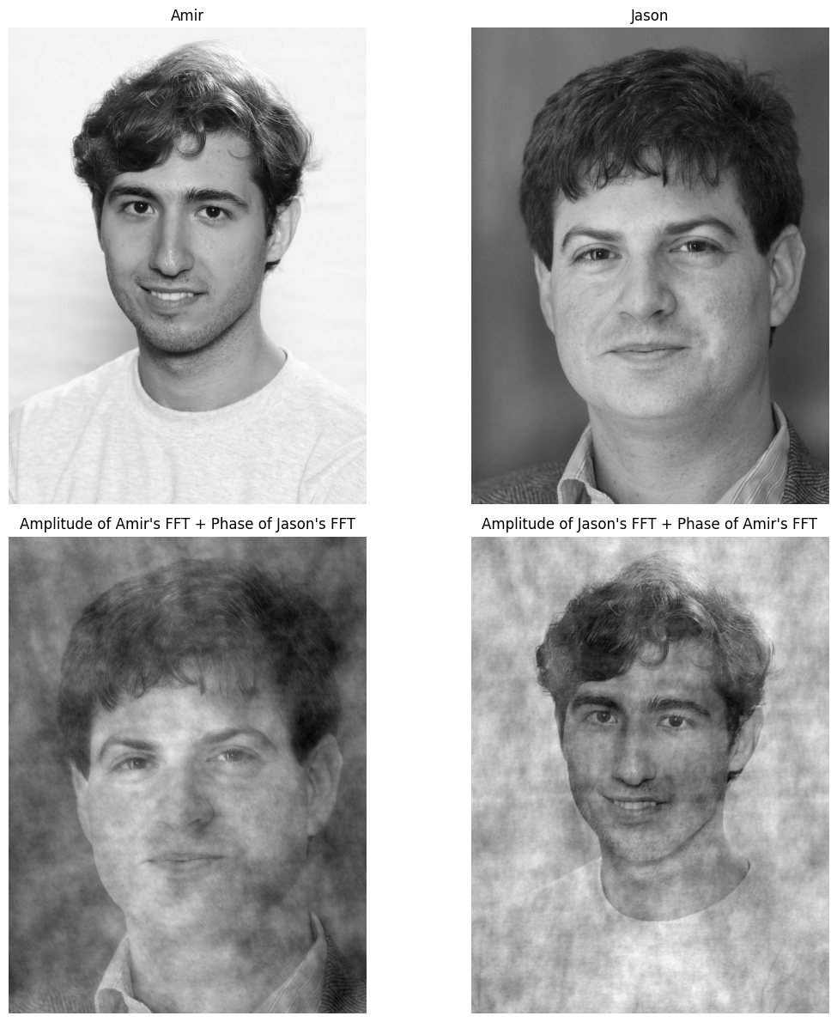
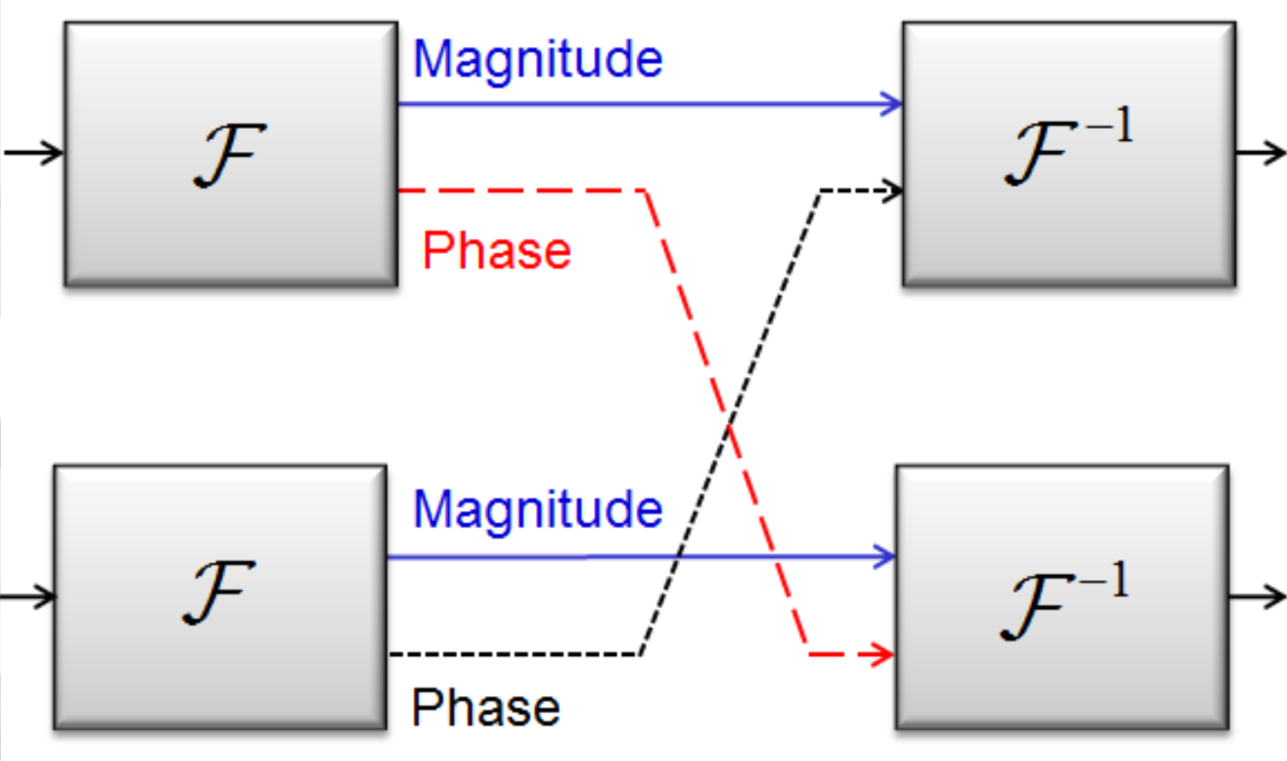
Why does Phase Matter?
Intensity of light doesn’t change so much in transparent materials!
Phase Contrast Imaging: Enhances contrast by detecting phase shifts in light.
More information in phase of Fourier Transform of an image!

Slide 5
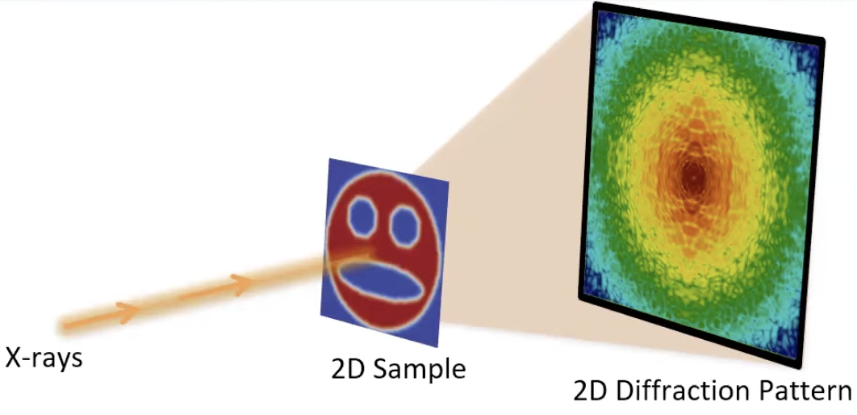
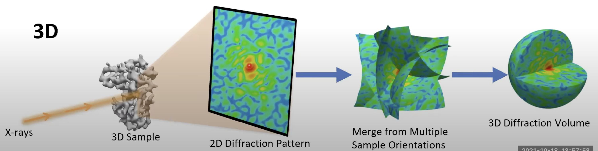
Phase Problem Example: Coherent Diffraction Imaging (CDI)
In CDI, a highly coherent beam of wavelike particle (X-rays, electrons, photons) is incident on an object.
Diffraction pattern = Magnitude of the Fourier transform of the object (In far-field)
Phase is not captured!

Slide 6
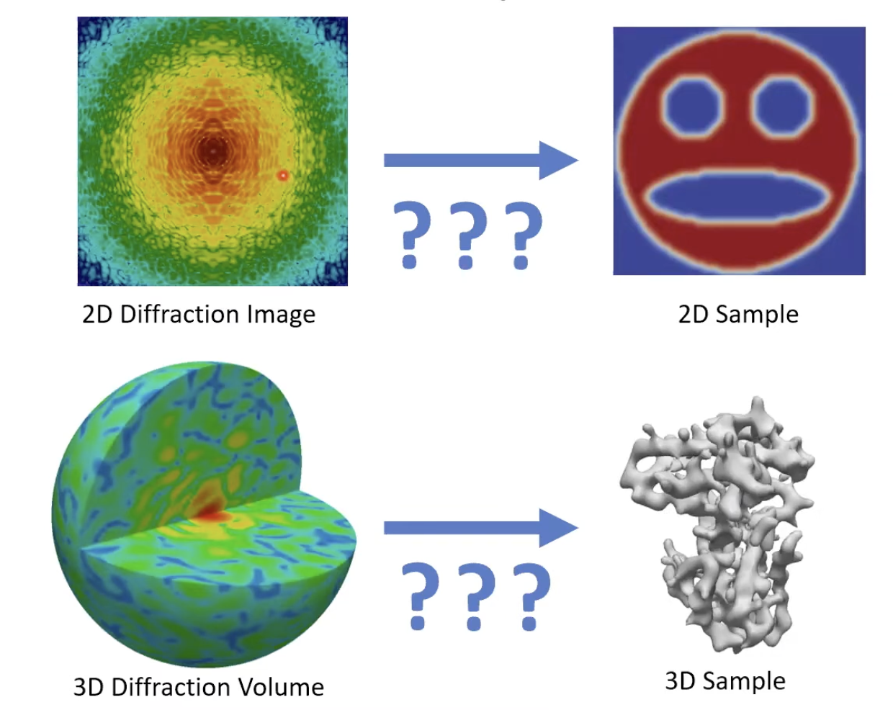
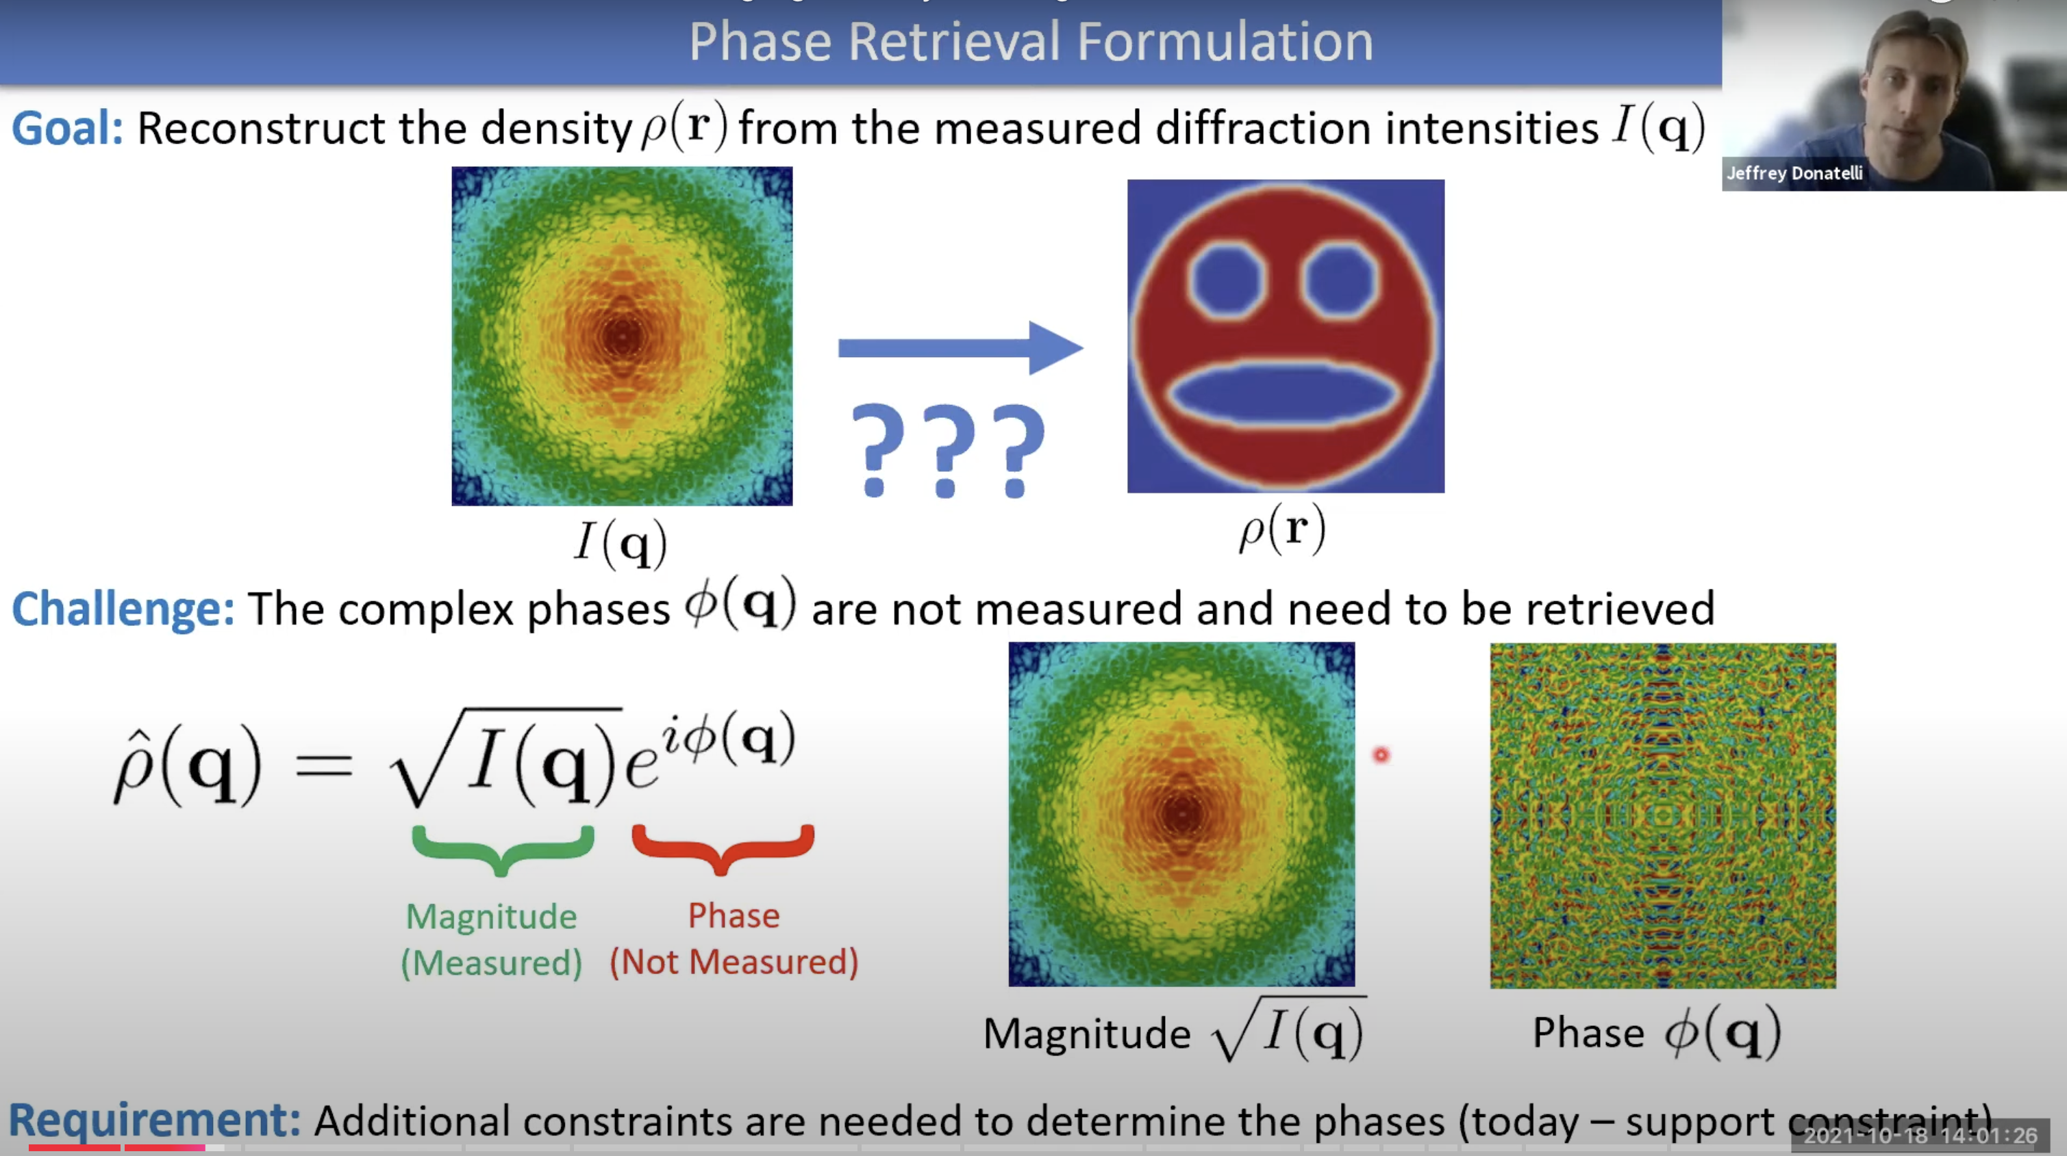
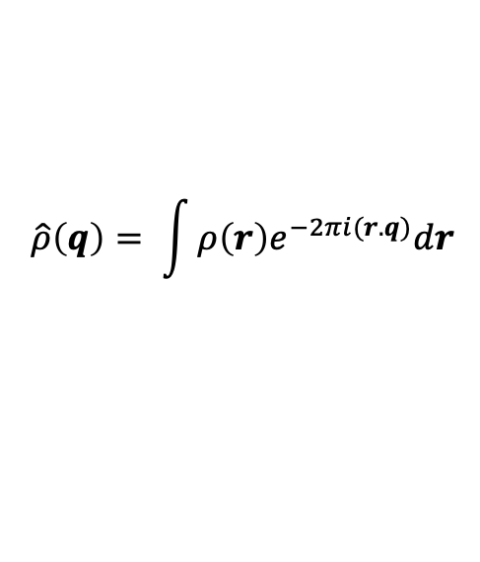
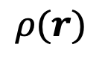
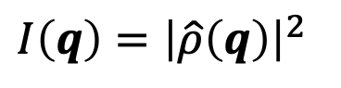
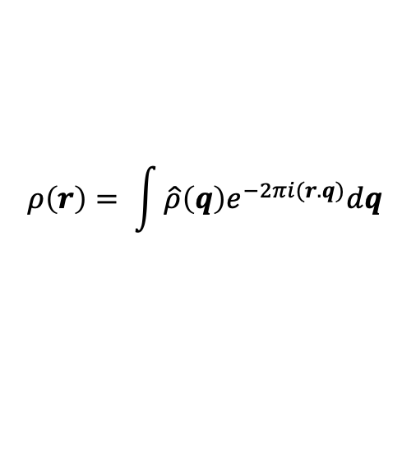
Notation
Fourier Transform
Inverse Fourier Transform
$$\hat{ρ}\left(q\right)= \int{ρ\left(r\right)e^{−2πi(r.q)}dr}$$
$$ρ\left(r\right)= \int{\hat{ρ}\left(q\right)e^{−2πi(r.q)}dq}$$
Continuous
Sample Electron Density
Diffraction Intensity
$$ρ(r)$$
$$I\left(q\right)={\left|\hat{ρ}\left(q\right)\right|}^{2}$$

Slide 7
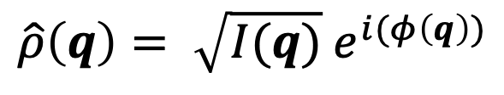
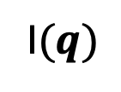
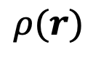
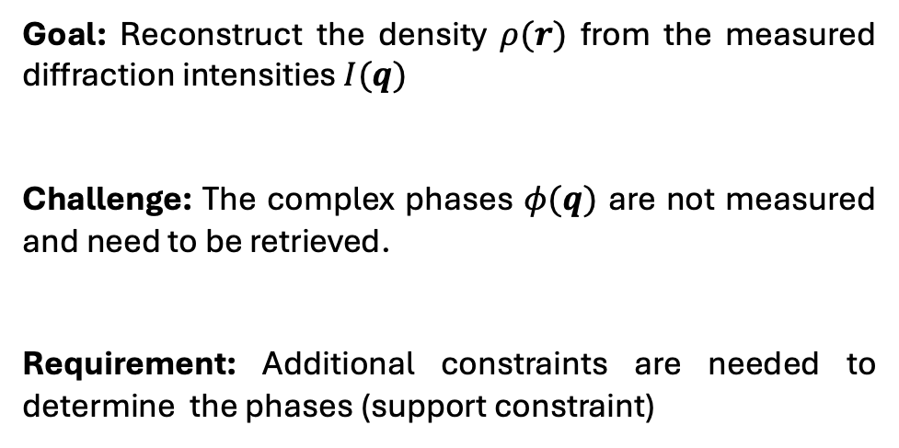
What is Phase Retrieval problem?
$$\hat{ρ}\left(q\right)= \sqrt{I(q)} e^{i(φ\left(q\right))}$$
Magnitude
Measured
Phase
Not Measured
Goal: Reconstruct the density $ρ(r)$ from the measured diffraction intensities $I(q)$
Challenge: The complex phases $φ(q)$ are not measured and need to be retrieved.
Requirement: Additional constraints are needed to determine the phases (support constraint)
I$(q)$
$$ρ(r)$$

Slide 8
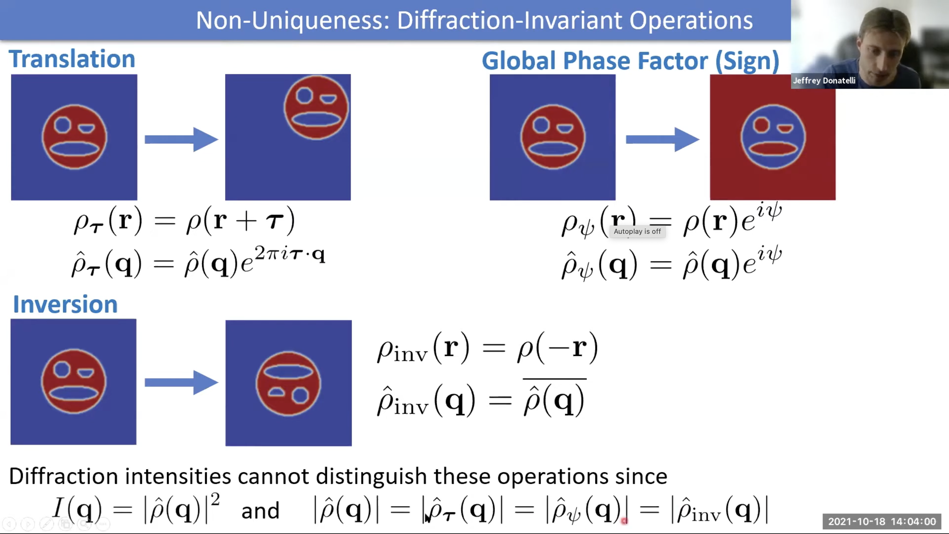
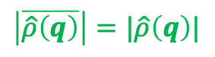

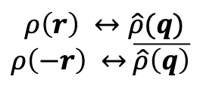
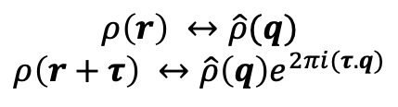
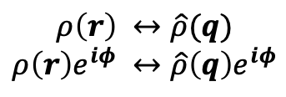
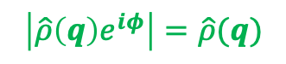
How hard is Phase Retrieval?
$$ρ\left(r\right) ↔\hat{ρ}(q)$$
$$ρ\left(r+τ\right) ↔\hat{ρ}\left(q\right)e^{2πi(τ.q)}$$
Translation
$$\left|\hat{ρ}\left(q\right)e^{2πi\left(τ.q\right)}\right|=\left|\hat{ρ}\left(q\right)\right|$$
Inverse Problem
$$ρ\left(r\right) ↔\hat{ρ}(q)$$
$ρ\left(−r\right) ↔$ $\overline{\hat{ρ}\left(q\right)}$
Inversion
$$\left|\overline{\hat{ρ}\left(q\right)}\right|=|\hat{ρ}\left(q\right)|$$
$$ρ\left(r\right) ↔\hat{ρ}(q)$$
$$ρ\left(r\right)e^{iφ} ↔\hat{ρ}\left(q\right)e^{iφ}$$
Global Phase Factor
$$\left|\hat{ρ}\left(q\right)e^{iφ}\right|=\hat{ρ}(q)$$

Slide 9
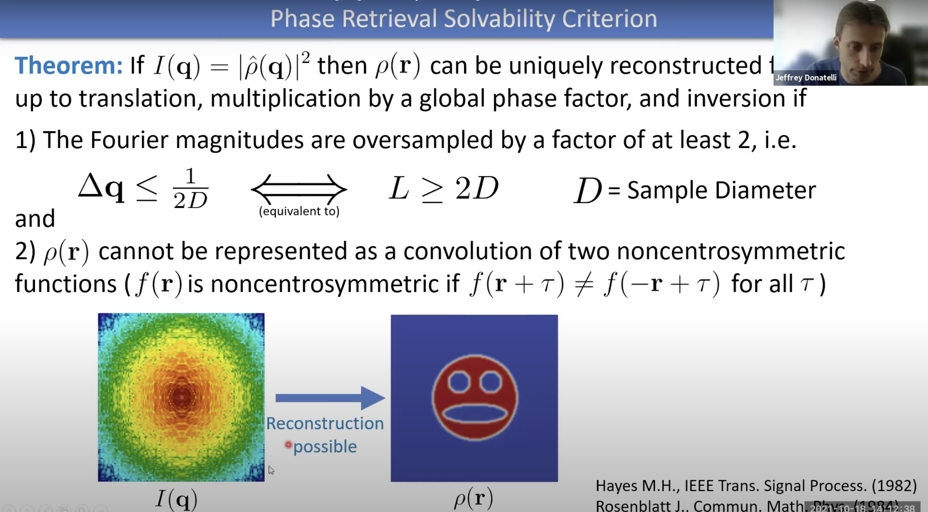
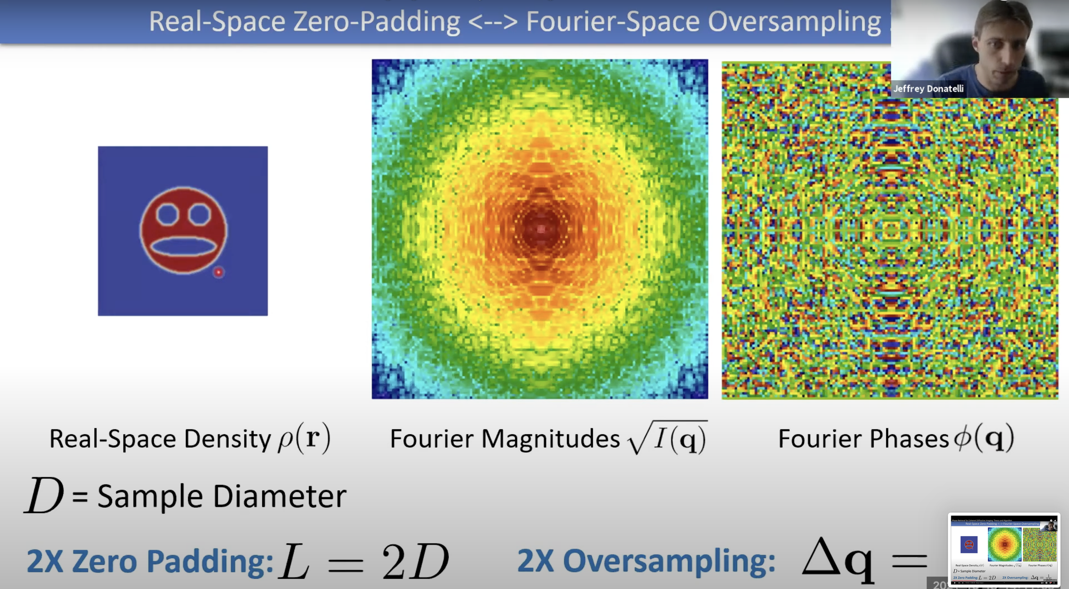
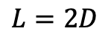
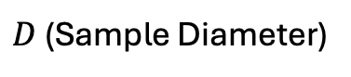
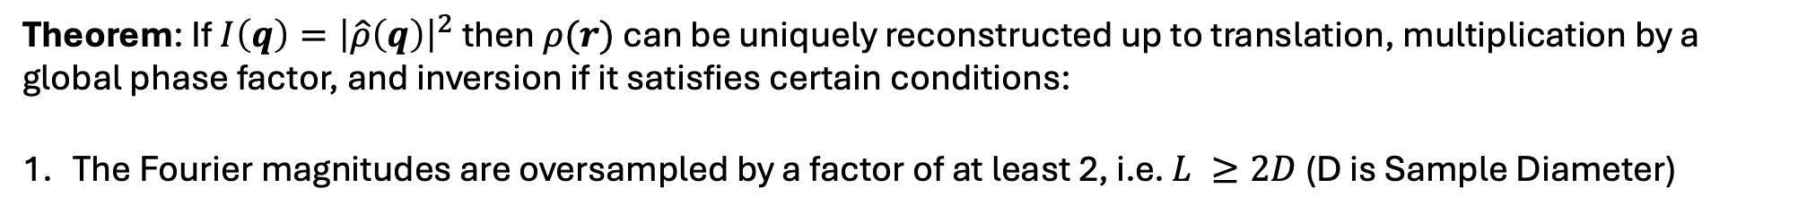
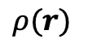

Phase Retrieval Solvability Criterion
Theorem: If $I\left(q\right)={\left|\hat{ρ}\left(q\right)\right|}^{2}$ then $ρ(r)$ can be uniquely reconstructed up to translation, multiplication by a global phase factor, and inversion if it satisfies certain conditions:
The Fourier magnitudes are oversampled by a factor of at least 2, i.e. $L ≥2D$ (D is Sample Diameter)
$D$(Sample Diameter)
$$L=2D$$
$$ρ(r)$$
Fourier Magnitudes
$\sqrt{I(q)}$
The sample should not be homometric. However, you have no control over it, and it’s rare! [Additional Slides]

Slide 10
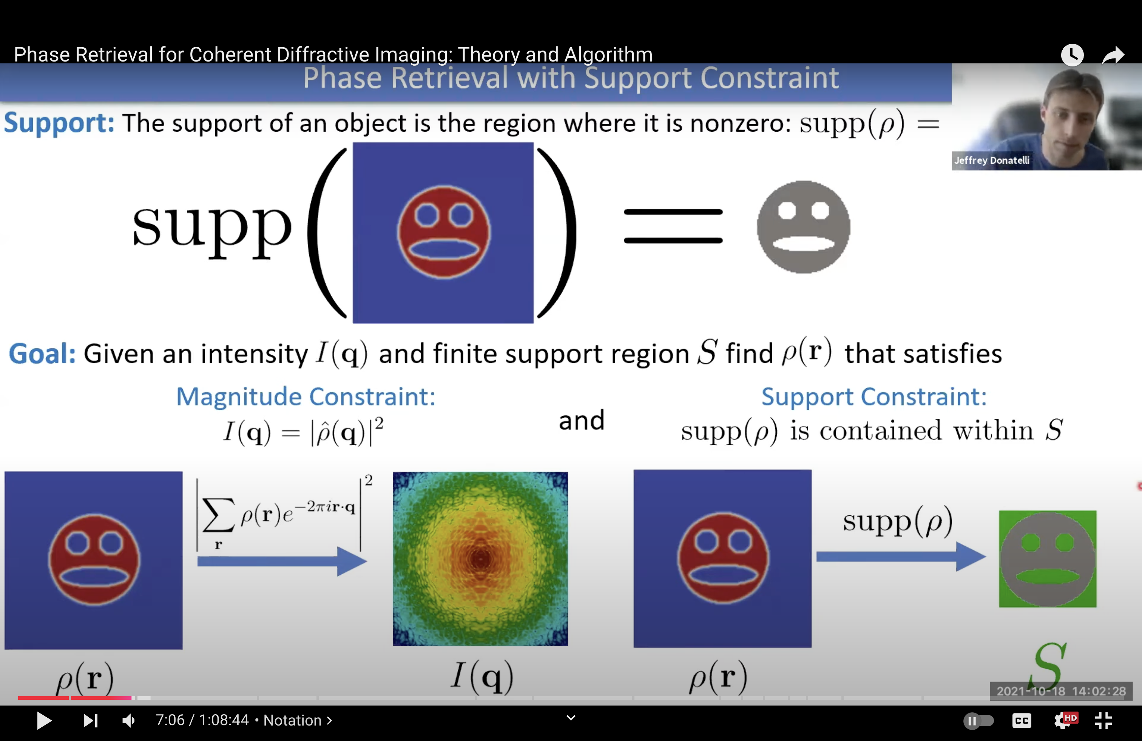
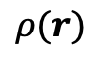
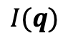
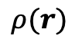
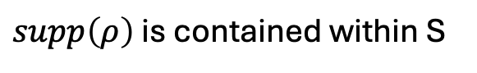
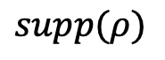
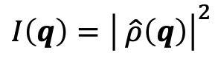
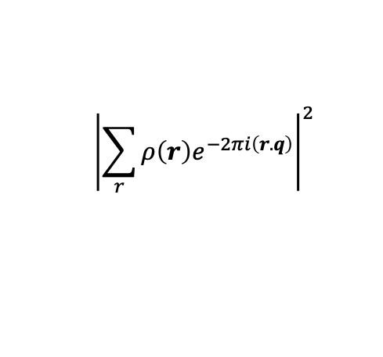
Phase Retrieval with support constraint
Support: The support of an object is the region where it is nonzero
Goal: Given an intensity $I(q)$ and finite support region $S$ find $ρ(r)$ that satisfies:
Magnitude Constraint
Support Constraint
$$I\left(q\right)={\left| \hat{ρ}\left(q\right)\right|}^{2}$$
$supp\left(ρ\right)$ is contained within S
$${\left|\sum_{r}{ρ\left(r\right)e^{−2πi\left(r.q\right)}}\right|}^{2}$$
$$supp(ρ)$$
$$ρ(r)$$
$$I(q)$$
$$ρ(r)$$

Slide 11
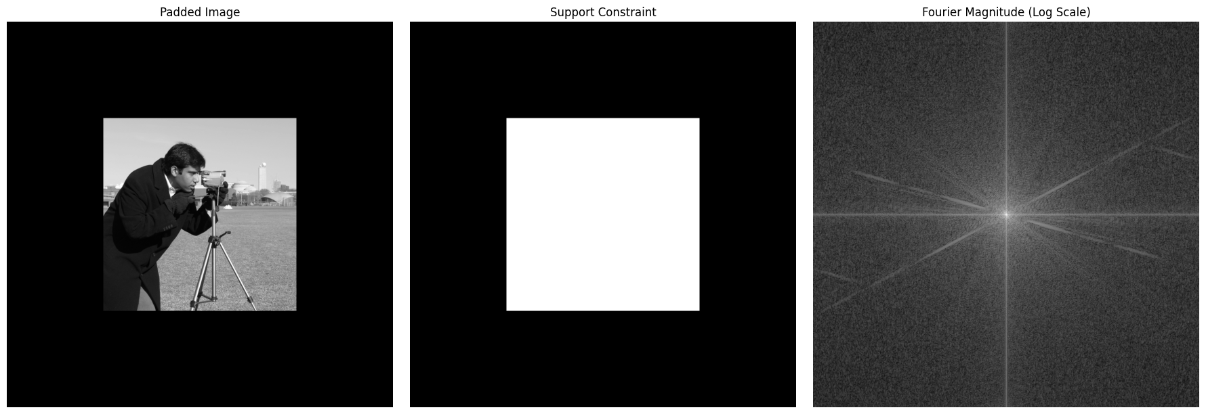
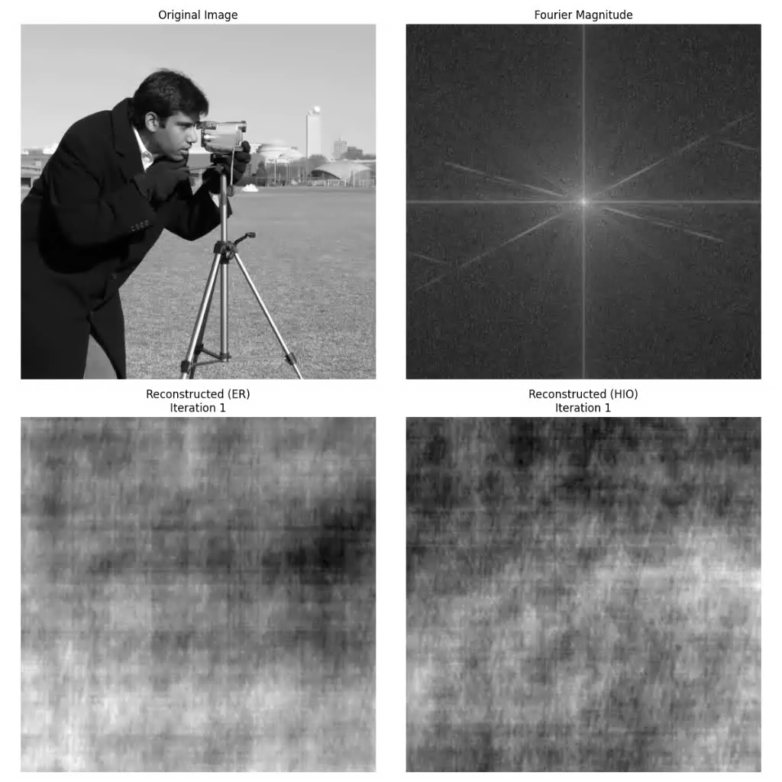
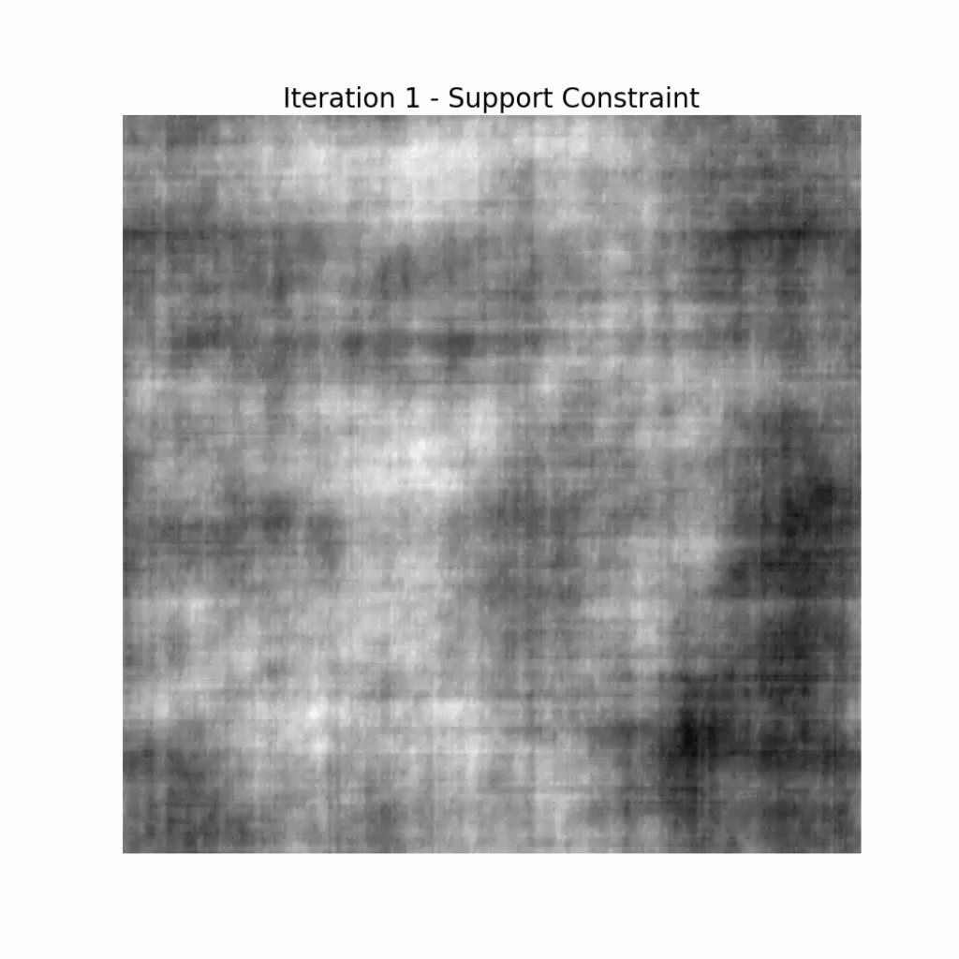
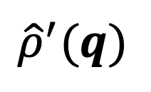
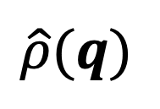
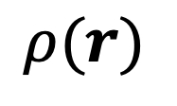
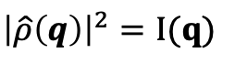
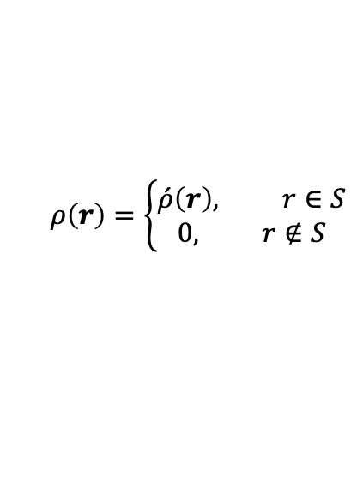
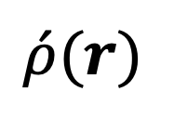
Error Reduction Algorithm (ER)
Image
Support
Fourier Magnitude
Fourier Transform
$$ρ(r)$$
$$\hat{ρ}(q)$$
$$ρ\left(r\right)=\left\{\begin{aligned}\acute{ρ}\left(r\right), r∈S \\ &0, r∉S\end{aligned}\right.$$
Support Constraint
Magnitude Constraint
${\left|\hat{ρ}\left(q\right)\right|}^{2}=I(q)$
Inverse Fourier Transform
$$\acute{ρ}(r)$$
$${\hat{ρ}}^{′}(q)$$

Slide 12
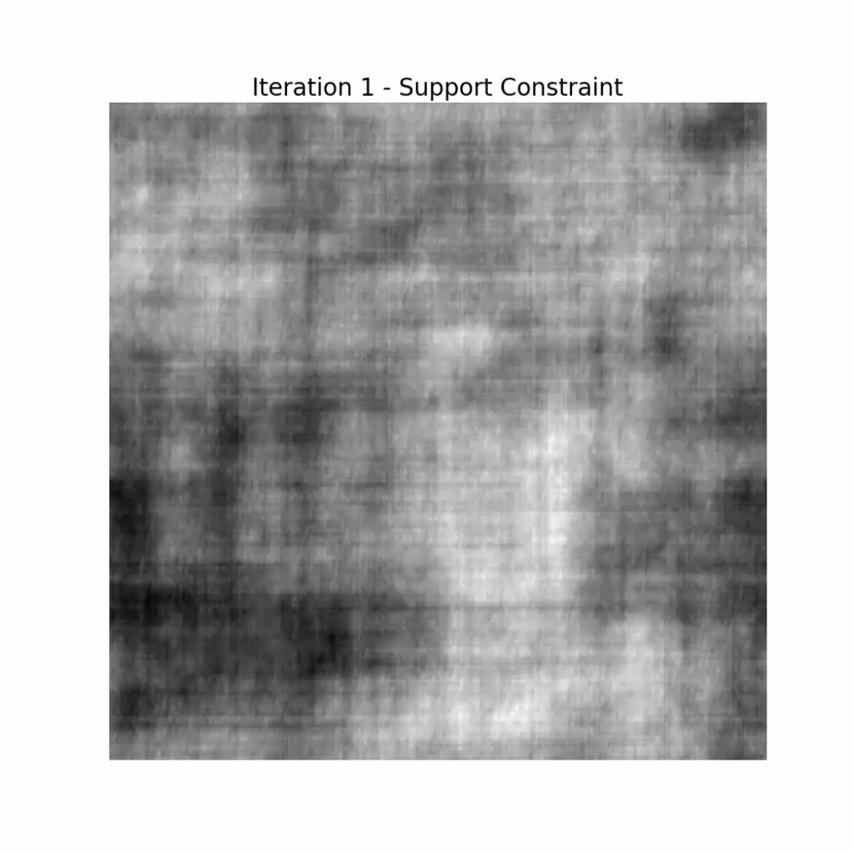




Hybrid Input-Output Algorithm (HIO)
Image
Support
Fourier Magnitude
Fourier Transform
$$ρ(r)$$
$$\hat{ρ}(q)$$
$$ρ\left(r\right)=\left\{\begin{aligned}\acute{ρ}\left(r\right), r∈S \\ &ρ_{old}(r)−β\acute{ρ}(r), r∉S\end{aligned}\right.$$
Support Constraint
Magnitude Constraint
${\left|\hat{ρ}\left(q\right)\right|}^{2}=I(q)$
Inverse Fourier Transform
$$\acute{ρ}(r)$$
$${\hat{ρ}}^{′}(q)$$

Slide 13
Comparison of HIO and ER Algorithms

Slide 14

Current Research
[1]: Diffusion Posterior Sampling for General Noisy Inverse Problems
[2]: DOLPH: Diffusion Models for Phase Retrieval
[3]: prDeep: Robust Phase Retrieval with a Flexible Deep Network
[4]: Phase Retrieval: From Computational Imaging to Machine Learning
.
.
.
2012: Beginning of the deep learning era with the AlexNet paper, authored by Geoffrey E. Hinton, a winner of the 2024 Nobel Prize in Physics!

Slide 15
Thanks for your attention!

Slide 16






Additional Slides: Imaging Through Thin Scattering Media
Angular memory effect: Rotating the incident beam over small angles $θ$ does not significantly change the resulting speckle pattern; rather, it only translates it over a distance $Δr≈θd$
Theorem: Operations of convolution and autocorrelation can be interchanged.
Speckle scale must be smaller than object size $→$
$$≈δ(x)$$
$${\left|ℱ\left\{I\right\}\right|}^{2}={\left|ℱ\left\{0\right\}\right|}^{2} →$$
Phase is lost!
Ref: Non-invasive imaging through opaque scattering layers, Nature 2012

Slide 17





Additional Slides: Homometric Structure
Translation
$$ρ\left(r\right) ↔\hat{ρ}(q)$$
$$ρ\left(r+τ\right) ↔\hat{ρ}\left(q\right)e^{2πi(τ.q)}$$
$$\left|\hat{ρ}\left(q\right)e^{2πi\left(τ.q\right)}\right|=\hat{ρ}\left(q\right)$$
Inversion
$$ρ\left(r\right) ↔\hat{ρ}(q)$$
$ρ\left(−r\right) ↔$ $\overline{\hat{ρ}\left(q\right)}$
$$\left|\overline{\hat{ρ}\left(q\right)}\right|=|\hat{ρ}\left(q\right)|$$
Homometric Structure: Example of two homometric structures (top) formed by the convolution between two non-centrosymmetric structures (bottom) with different orientations. [$f(r)$ is non-centro-symmetric if $f\left(r+τ\right)≠f\left(−r+τ\right)$ for all $τ]$
1D: Almost all 1D functions have homometric structure
2D: Homometric structures are very rare in 2 and higher dimensions
Global Phase Factor
$$ρ\left(r\right) ↔\hat{ρ}(q)$$
$$ρ\left(r\right)e^{iφ} ↔\hat{ρ}\left(q\right)e^{iφ}$$
Ref: Homometric structures, Wikipedia

